Slide 1
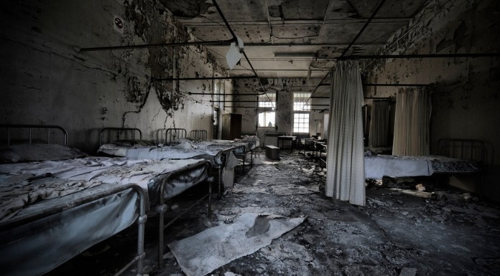
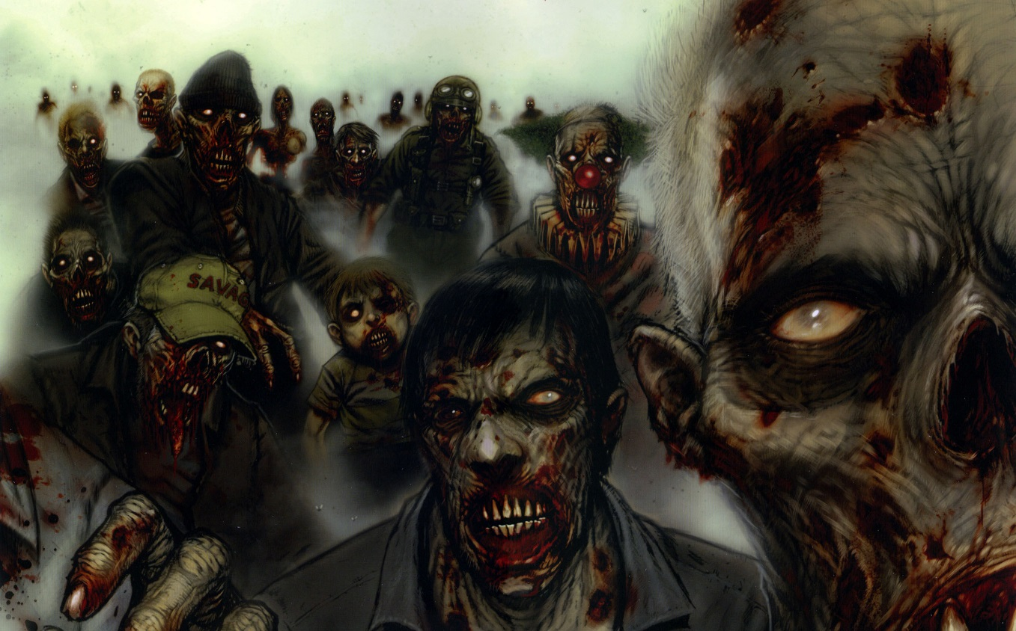
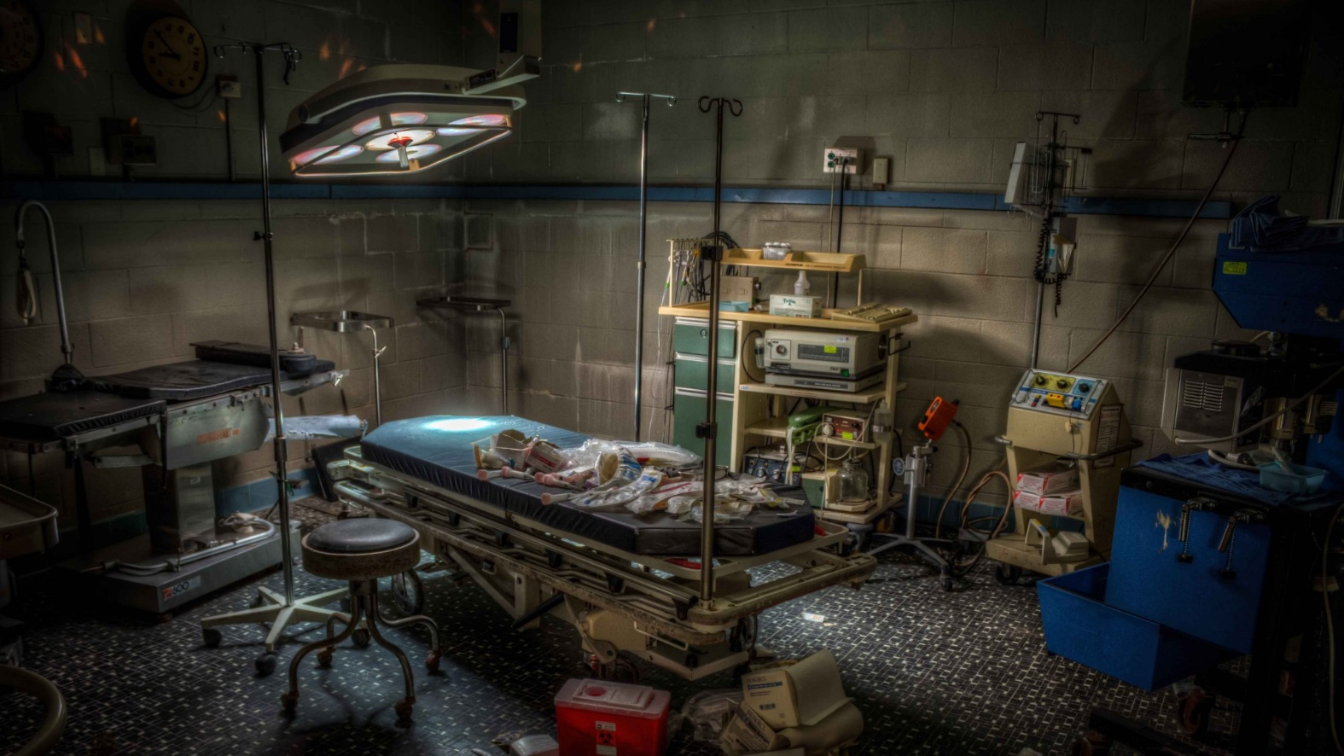

NAME OF GAME WE DO NOT
HAVE YET

Slide 2
Group 16
Akansha Garg
Gabe Whale
Ryan Harris
Ellie Robins
Bedoor Bahassan
Oliver Bradford-Tolley
Jiayi Chen
Chienn Ngu

Slide 3
Game overview

Slide 4
Main Features of our game
Difficulties
Energy levels
Fighting abilities
Craft building
Time countdown
Randomization

Slide 5
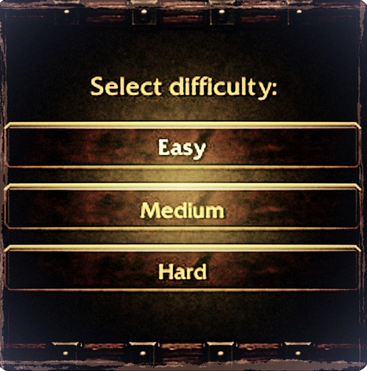
Difficulty levels
Easy – unlimited lives, energy decreases at a slower rate.
Medium – 6 lives, energy decreases at a faster rate.
Hard – 1 life, energy decreases at the fastest rate.

Slide 6

Energy
Begin game at a midway on energy level.
Gain energy by eating,.
Lose energy by time countdown, walking up/down stairs, moving rooms.
X-ray room has major impact – faster countdown in this room and then energy drops more dramatically.

Slide 7
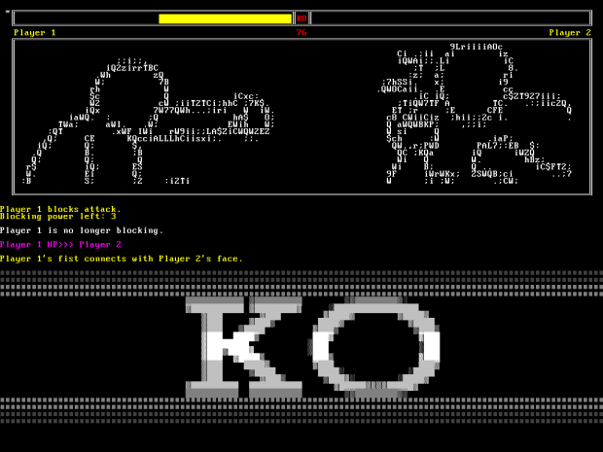
Fighting abilities
Fighting turn by turn based.
Use weapons found in game.
Harder the difficulty changes the damage the weapons you are fighting with can do.
Fighting can change end of game result – if lose fight infected by zombies and lose a life/lose game.

Slide 8
Craft building
Find items throughout hospital building in game
Use items to build a certain craft that can be used to escape

Slide 9
Time countdown
General countdown in whole of game in order to make it a rush so its more exciting to find an escape.
X-ray room countdown faster for that individual room – running out of time can result in a death

Slide 10
Randomisation
There are hiding places for each item.
Every item is vital for survival during the game.
Every game item is randomly hidden throughout game.
Makes game more interesting as it will change every time.

Slide 11
Enjoy our demonstration of
“Name of game we don’t have yet”

